Slide 1
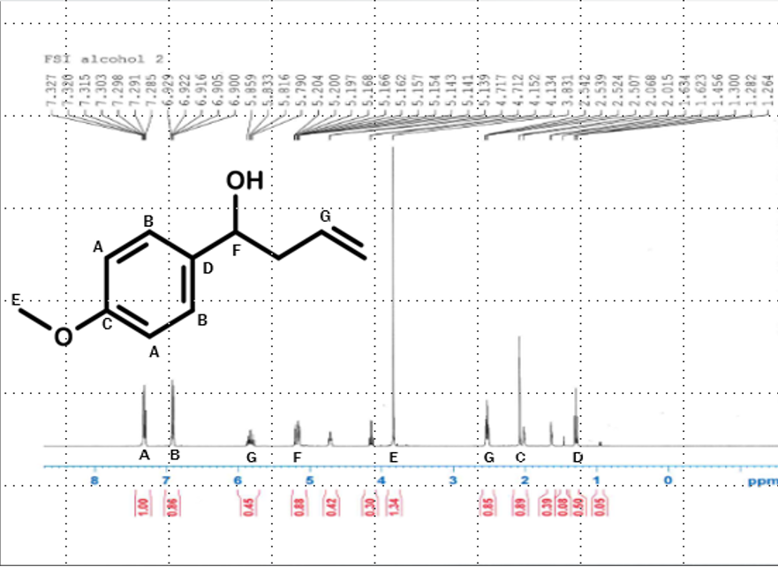
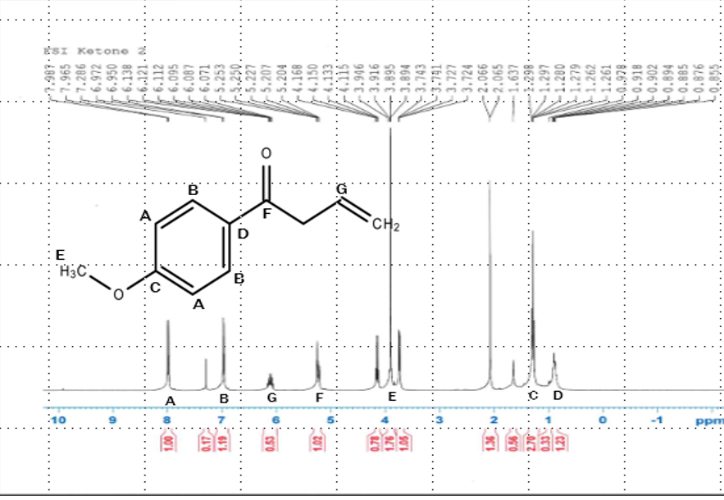
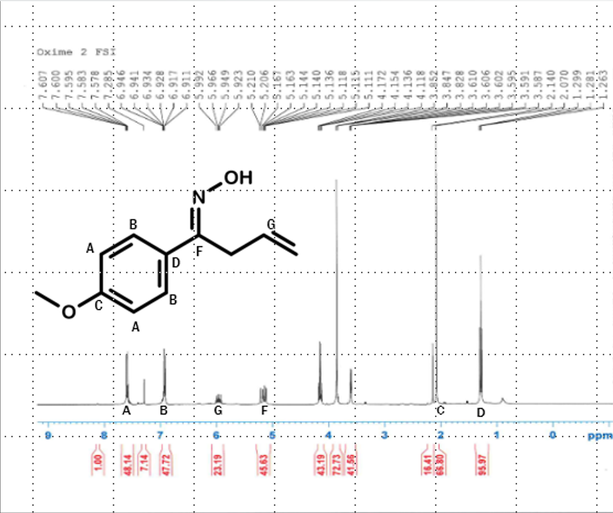
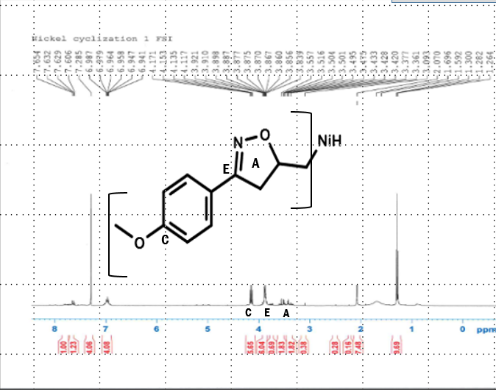
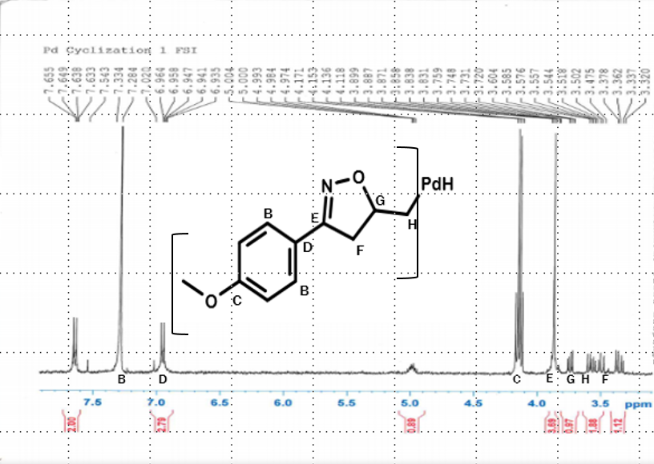
Synthesis of two 3,5-Disubstituted Δ²-isoxazolines
Ethan Bodak¹, Dylan Wardle¹, and Benjamin Schottler²
¹Frontiers of Science Institute
²Department of Chemistry and Biochemistry, University of Northern Colorado, Greely CO
Abstract
Results
Conclusion
Macrophage migration inhibitory factor (MIF) is responsible for many chronic inflammatory and autoimmune diseases, including type 1 and type 2 diabetes, as well as multiple cancers.
Iso-1 (a specific drug categorized as an isoxazoline) has been proven to inhibit MIF in mice, and are therefore potential treatments for these various inflammatory diseases.
There is debate as to which reactants will lead to the most desired products, and which derivatives off of the isoxazole ring work the best in the synthesis reactions to create isoxazolines.
One of the two 3,5-Disubstituted Δ²-isoxazolines made in this project uses nickel as a metal catalyst, while the other uses palladium as metal catalyst, and both include the essential isoxazole ring found in all functional isoxazolines.
Both isoxazolines are relatively low-cost to make, and therefore have the potential to be commercialized on a mass scale in order to treat the many who suffer from autoimmune and chronic inflammatory diseases.
The synthesis for the nickel-based 3,5-Disubstituted ∆²-isoxazoline was only partially successful. This failure could be because the nickel is not strong enough to cyclize through the reaction completely, or because it was not strong enough keep the form of the isoxazole ring. Of course, the poor results could also be due simply to human error, a factor that is always present in research.
The synthesis for the palladium-based 3,5-Disubstituted ∆²-isoxazoline, on the other hand, proved to be fairly successful and pure. However, the proton NMR taken of the palladium-based 3,5-Disubstituted ∆²-isoxazoline suggested that the palladium derivative fell off of the carbon chain.
The success of the palladium-based cyclization could be due to a number of reasons:
Palladium could be better at cyclizing than nickel
Palladium could be stronger at holding the structure of the isoxazole ring
Palladium holds its electrons better that the nickel
Proton NMR of 1-(4-methoxyphenyl)-3-buten-1-ol
Proton NMR of 1-(4-methoxyphenyl)-3-buten-1-one
Background
Future Studies
MIF functions as a proinflammatory cytokine involved in most inflammatory reactions, as well as promotes the release of insulin. These characteristics are what make MIF a key part in the onset of diabetes, and a producer of cancer symptoms.
Recent research suggests that isoxazolines not only shield ß-cells in the pancreas (thus combating diabetes), but also inhibit MIF by binding to its catalytic sites and lowering its protein production.
More recent research suggests that an ideal way to synthesize isoxazolines involves a Grignard reaction of p-anisaldehyde with a metalloid followed by oxidation of an alcohol with the 3-buten-1-ol functional group with pyridinium chlorochromate (PCC) to form a ketone with the functional group 3-buten-1-one. The ketone is then treated with a hydroxylamine and a form of acetate. The final synthesis involves a cyclization with a metalloid to close the isoxazole ring, thus creating a form of isoxazoline.
These synthesis reactions have proven to produce high yields, and are fairly cost-efficient.
There is currently not a lot of research on the nickel-based 3,5-Disubstituted ∆²-isoxazoline. It is predictable that more research will be done on this nickel-based isoxazoline in the future due to its promise. However, if the nickel proves to be inadequate at cyclizing to form the isoxazole ring research regarding it will be discontinued.
There will probably be much more research done on the palladium-based cyclization because of its proven success rate.
More experiments will also be performed with many more derivatives and reactants to find out the most effective way to produce 3,5-Disubstituted ∆²-isoxazolines, as well as which derivatives work the best to inhibit MIF and shield ß-cells in the pancreas.
All of this research will be geared towards synthesizing 3,5-Disubstituted ∆²-isoxazolines as effective MIF inhibitors that can treat diabetes and cancer.
Proton NMR of (IE)-N-hydroxy-1-(4-methoxyphenyl)-3-buten-1-imine
Proton NMR nickel-based 3,5-Disubstituted ∆²-isoxazoline
Proton NMR of palladium-based 3,5-Disubstituted ∆²-isoxazoline
Methodology
Results Continued
Acknowledgements
The synthesis of both 3,5-Disubstituted ∆²-isoxazolines began with the following steps:
P-anisaldehyde was reacted with allylmagnesium chloride in what is known as a Grignard reaction. This reaction essentially lengthened the carbon chain of the p-anisaldehyde. This branch of the carbon chain will eventually connect the isoxazole ring to the rest of the molecule. The product formed by this reaction was 1-(4-methoxyphenyl)-3-buten-1-ol.
1-(4-methoxyphenyl)-3-buten-1-ol was then reacted with pyridinium chlorochromate (PCC) in a type of reaction called oxidation. In this reaction, the PCC was the oxidizer, which essentially acted by removing a hydrogen from the 1-(4-methoxyphenyl)-3-buten-1-ol. The end product was 1-(4-methoxyphenyl)-3-buten-1-one (the only difference being the missing hydrogen.
The newly-made 1-(4-methoxyphenyl)-3-buten-1-one was reacted with hydroxylamine hydrochloride in order to form a product called an oxime. This oxime will be the starting material from which both isoxazolines will be formed. The oxime made was (IE)-N-hydroxy-1-(4-methoxyphenyl)-3-buten-1-imine.
The final synthesis of the 3,5-Disubstituted ∆²-isoxazolines was made through separate cyclization reactions, each involving different metalloids to form the different isoxazolines:
(IE)-N-hydroxy-1-(4-methoxyphenyl)-3-buten-1-imine was then reacted with nickel (II) chloride as a catalyst, and palladium (II) chloride was used for a separate reaction, thus forming two 3,5-Disubstituted ∆²-isoxazolines, one nickel-based, the other palladium-based.
Results for Grignard reaction:
The theoretical yield for the Grignard reaction was 1.3092 g of 1-(4-methoxyphenyl)-3-buten-1-ol, while the actual yield turned out to be 0.7861 g. Therefore, the percent yield was calculated to be 60%.
After the reaction was complete and the product was purified, a proton NMR was taken of the 1-(4-methoxyphenyl)-3-buten-1-ol. The NMR shows that the product made was pure.
Results for oxidation reaction:
The theoretical yield for the oxidation reaction was 0.7771 g of 1-(4-Methoxyphenyl)-3-buten-1-one, while the actual yield was massed out to 0.6635 g. From this data, the percent yield was determined to be 75%.
Once the reaction had finished and the end product isolated, another proton NMR was taken, this time of the 1-(4-methoxyphenyl)-3-buten-1-one. This NMR also shows the compound to be fairly pure.
Results for oxime reaction:
It was determined that the theoretical yield for the oxime reaction was 0.5818 g of (IE)-N-hydroxy-1-(4-methoxyphenyl)-3-buten-1-imine. The actual yield of the product was 0.4997 g, yielding 86% product.
The oxime was filtered and purified, and a proton NMR was taken. The results showed the oxime to be pure as well.
Results for nickel (II) synthesis:
The theoretical yield for the nickel synthesis was 0.153 g of the nickel-based 3,5-Disubstituted ∆²-isoxazoline, while the actual yield was 0.1098 g. The percent yield, therefore, was 72%.
After the isoxazoline was purified, a proton NMR was taken of it, and the results showed that little product had actually been made.
Results for palladium (II) synthesis:
The theoretical yield for the palladium synthesis was o.1796 g of the palladium-based 3,5-Disubstituted ∆²-isoxazoline, while the actual yield was 0.0796 g, yielding 44% product.
Research:
Benjamin Schottler
Michael D. Mosher
Poster:
Matthew DeSelm
Research:
Norman, A. L., Shurrush, K. A., Calleroz, A. T., & Mosher, M. D. (2007, July 23). A tandem oximation-cyclization route to ∆²-isoxazolines.
Norman, A. L., Mosher, M. D. (2008, April 22). Enantioselectivity in the synthesis of 3,5-disubstituted ∆²-isoxazolines.
Khoufache, K., Bazin, S., Girard, K., et al. (2012, April 19). Macrophage Migration Inhibitory Factor Antagonist Blocks the Development of Endometriosis In Vivo.
Asare, Y., Schmitt, M., & Bernhagen, J. (2012, December 3). The vascular biology of macrophage migration inhibitory factor (MIF): Expression and effects in inflammation, atherogenesis and angiogenesis
Conroy, H., Mawhinney, L., & Donnelly, S. C. (2010, August 30). Inflamation and cancer: macrophage migration inhibitory factor (MIF)—the potential missing link.
Toso, C., Emamaulle, J. A., Merani, S., Shapiro, A. M. J. (2008, May 12). The role of macrophage inhibitory factor on glucose metabolism and diabetes.
Stojanović, I., Maksimović, D., Al-Abed, Y., et al. (2008). Control of the final stage of immune-mediated diabetes by ISO-1, and antagonist of macrophage migration inhibitory factor .
Al-Abed, Y., VanPatten, S. (2011). MIF as a disease target: ISO-1 as a proof-of-concept therapeutic.

