Slide 1
Synthesis of two 3,5-Disubstituted Δ²-isoxazolines
The next step against cancer and diabetes
By Ethan Bodak and Dylan Wardle

Slide 2
What are isoxazolines?
Isoxazolines are a series of drugs know as MIF inhibitors
MIF (macrophage migration inhibitory factor):
Proinflammatory cytokine
Responsible for chronic inflammatory and autoimmune diseases (diabetes and cancer)
Produces proteins responsible for inflammation
MIF? NO THANKS!

Slide 3
How do they work?
Isoxazoline binds to the MIF cells blocking the production of proteins
Because the proteins are blocked they can no longer attack the pancreas and other parts of the body and cause inflammation
The effect of this is that inflammation and swelling are reduced

Slide 4
Well, how are they made?
Current research suggests that an ideal way to synthesize isoxazoline involes a four-step process:
Grignard reaction of p-anisaldehyde → 3-buten-1-ol
Oxidation reaction of 3-buten-ol → 3-buten-1-one
Treatment of 3-buten-1-one with a hydroxylamine → oxime
Cyclization of oxime with a metalloid → form of isoxazoline

Slide 5
Our goal
Produce two different isoxazolines: one using a nickel catalyst, the other using palladium
Find out if isoxzolines can be produced en masse
Produce isoxazolines at a cheaper cost
Produce isoxazolines at higher yields

Slide 6
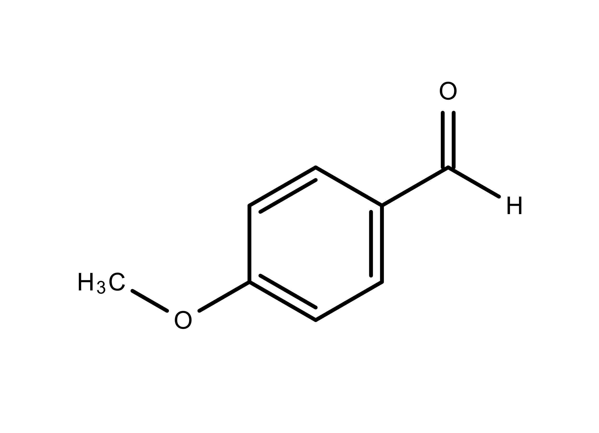
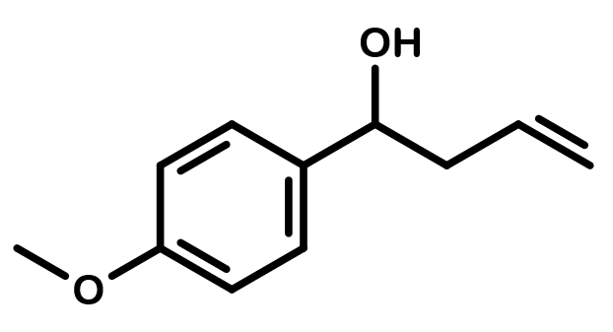
Our process: Grignard Reaction
allyl-magnesium chloride
tetrahydrofuran
Anhydrous reaction: done under argon gas
Added allyl-magnesium chloride slowly with needle and syringe
What did it do?
Lengthened carbon chain of p-anisaldehyde
P-anisaldehyde
1-(-4-methoxyphenyl)-3-buten-1-ol

Slide 7
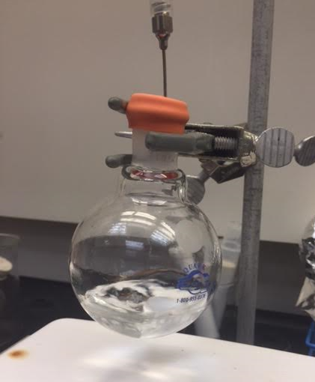
Setup for Grignard Reaction

Slide 8
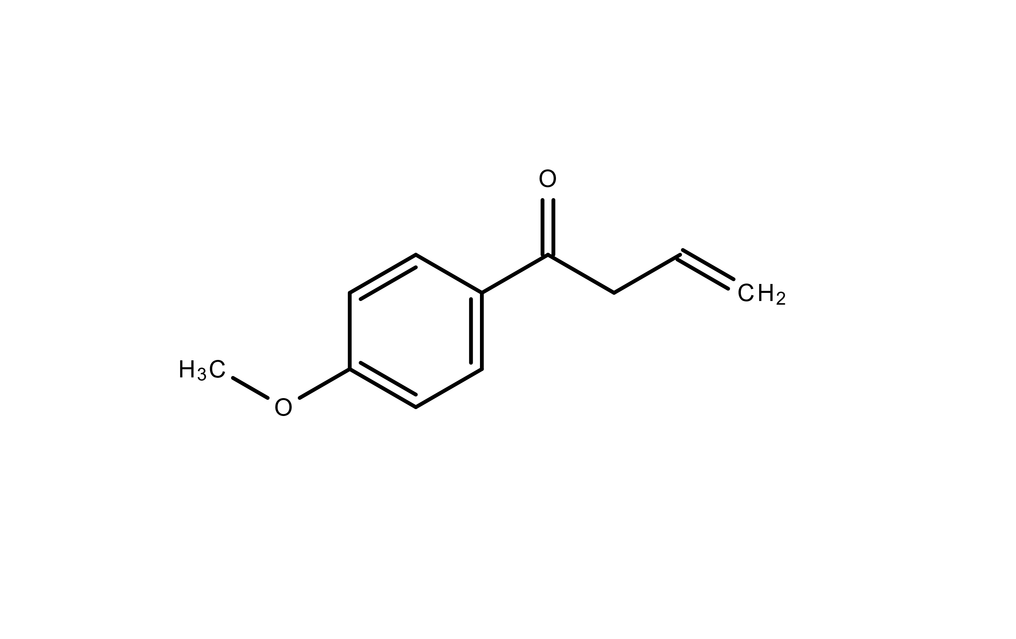
Oxidation Reaction
pyridinium chlorochromate + magnesium sulfate
Magnesium sulfate and dichloromethane smoothed reaction
What did it do?
Removed hydrogen from hydroxyl group and formed a double-bond
dichloromethane
1-(4-methoxyphenyl)-3-buten-1-ol
1-(4-methoxyphenyl)-3-buten-1-one

Slide 9
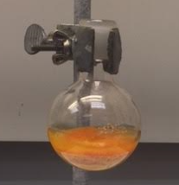
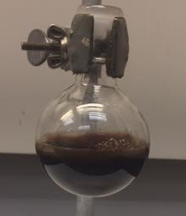
Color before reaction
Color after reaction

Slide 10
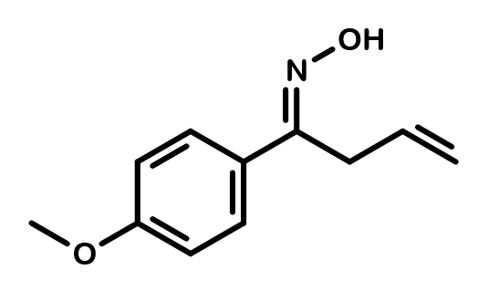
Reaction to form Oxime
hydroxylamine hydrochloride + sodium acetate trihydrate
Sodium acetate smoothed reaction
Reaction was heated
Reaction ran until solution dripped from condenser bulb
What did it do?
Formed the base for the isoxazole ring
50:50 deionized water to ethanol
1-(4-methoxyphenyl)-3-buten-1-one
(1E)-N-hydroxy-1-(4-methoxyphenyl)-3-buten-1-imine

Slide 11
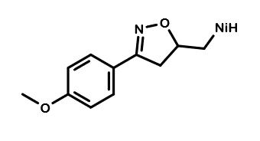
Nickel-Catalyzed Cyclization
nickel (II) chloride + copper (II) chloride
methanol
Copper (II) chloride oxidized the nickel
Anhydrous reaction
Reaction ran overnight
What did it do?
Cyclized isoxazole ring using nickel as a catalyst
(1E)-N-hydroxy-1-(4-methoxyphenyl)-3-buten-1-imine
nickel-catalyzed 3,5-Disubstituted ∆²-isoxazoline

Slide 12
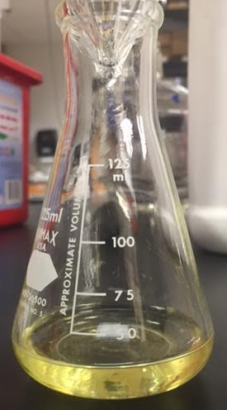
Ideal color of 3,5-Disubstituted Δ²-isoxazoline

Slide 13
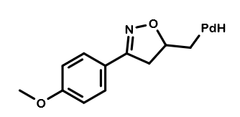
Palladium-Catalyzed Cyclization
Palladium (II) chloride + copper (II) chloride
methanol
Copper (II) chloride oxidized the palladium
Anhydrous reaction
Reaction ran overnight
What did it do?
Cyclized isoxazole ring using palladium as a catalyst
(1E)-N-hydroxy-1-(4-methoxyphenyl)-3-buten-1-imine
palladium-catalyzed 3,5-Disubstituted ∆²-isoxazoline

Slide 14
Ideal color of 3,5-Disubstituted Δ²-isoxazoline

Slide 15
Product Analysis
Two Methods:
Proton NMR (nuclear magnetic resonance)
Displays rough structure on a graph through integration of hydrogens
Solvent: chloroform-d
TLC (thin layer chromatography) plate
Separates based off of the relative polarity of compounds
Solvent: 80:20 hexane to ethyl acetate

Slide 16
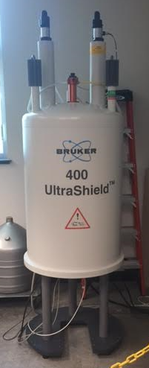
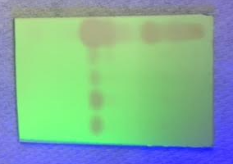
Nuclear magnetic resonance machine
Example of thin layer chromatography plate

Slide 17
Results: Grignard Reaction
Percent yield: 60% → low (should at least be >85%)
Calculation:
$\frac{Y_{actual}}{Y_{theoretical}} = \frac{0.7661 g OH}{1.3092 g OH}×100=60\%$

Slide 18
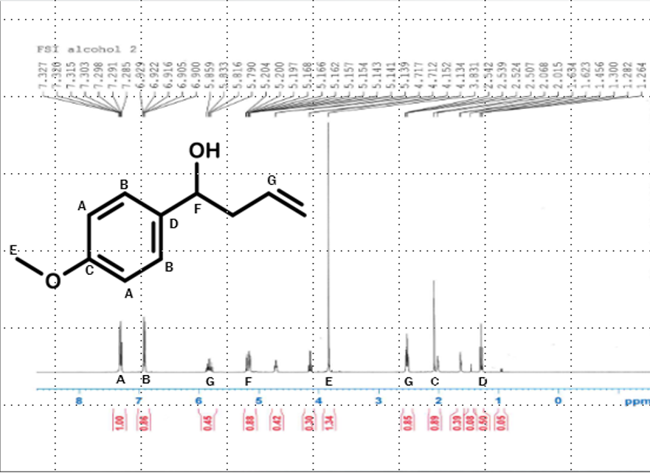
Proton NMR of 1-(4-Methoxyphenly)-3-buten-1-ol

Slide 19
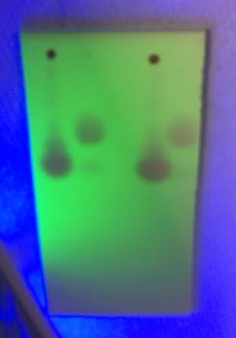
TLC plate comparing 1-(4-methoxyphenly)-3-buten-1-ol (long strands) to p-anisaldehyde (short strands)

Slide 20
Results: Oxidation Reaction
Percent yield: 75% → still low
Calculation:
$$\frac{Y_{actual}}{Y_{theoretical}} = \frac{0.6635 g Ket}{0.7771 g Ket} ×100=\text{75\%}$$

Slide 21
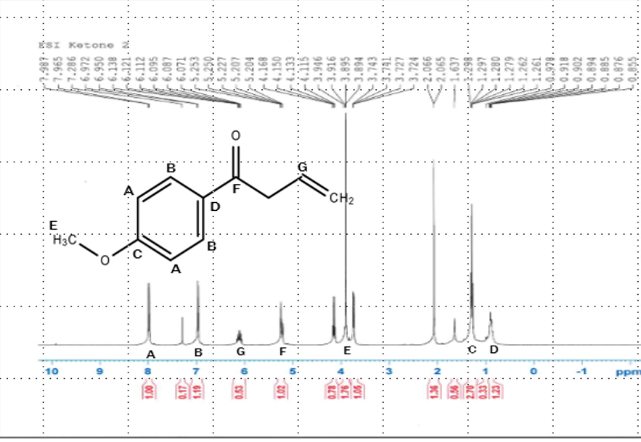
Proton NMR of 1-(4-Methoxyphenyl)-3-buten-1-one

Slide 22
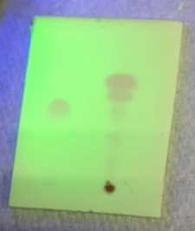
TLC plate comparing 1-(4-methoxyphenyl)-3-buten-1-ol (left) and 1-(4-methoxyphenyl)-3-buten-1-one (right).

Slide 23
Results: Oxime
Percent yield: 86% → fair
Calculation:
$$\frac{Y_{actual}}{Y_{theoretical}} = \frac{0.4997 g Ox}{0.5818 g Ox} ×100=\text{86\%}$$

Slide 24
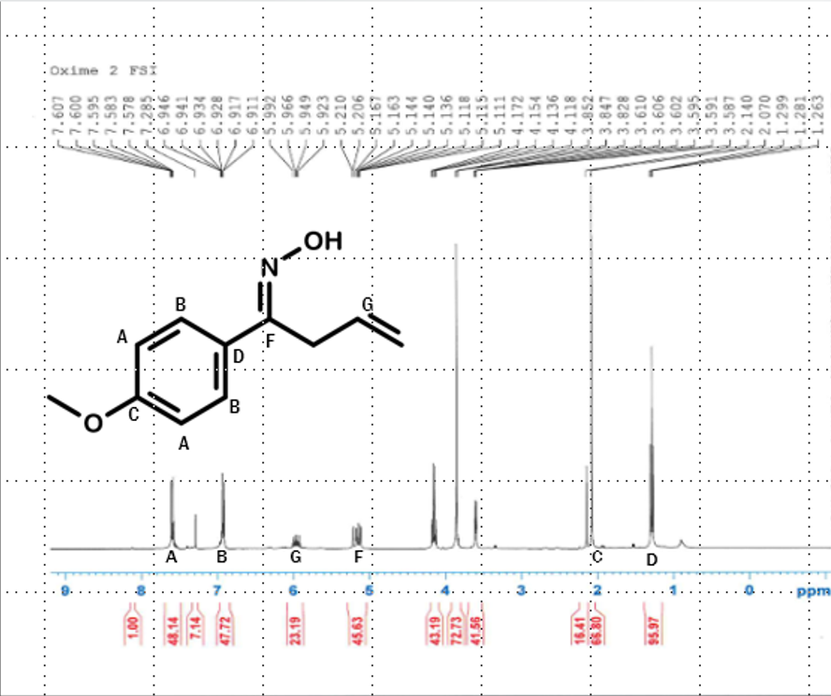
Proton NMR of (1E)-N-Hydroxy-1-(4-methoxyphenyl)-3-buten-1-imine

Slide 25
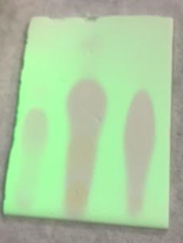
TLC plate comparing 1-(4-Methoxyphenyl)-3-buten-1-ol (left), 1-(4-Methoxyphenyl)-3-buten-1-one (middle), and (1E)-N-Hydroxy-1-(4-methoxyphenyl)-3-buten-1-imine (right)

Slide 26
Results: Nickel-Catalyzed Cyclization
Percent yield: 72% → low
Calculation:
$$\frac{Y_{actual}}{Y_{theoretical}} = \frac{0.1098 g Iso}{0.153 g Iso} ×100 =\text{72\%}$$

Slide 27
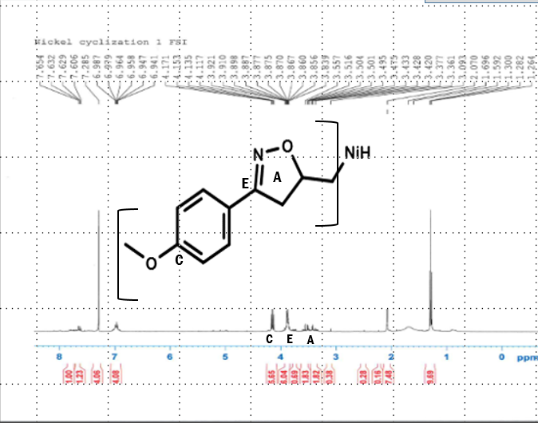
proton NMR of nickel-catalyzed 3,5-Disubstituted ∆²-isoxazoline

Slide 28
Results: Palladium-Catalyzed Isoxazoline
Percent yield: 44%
Calculation:
$$\frac{Y_{actual}}{Y_{theoretical}} = \frac{0.0796g Iso}{0.1796 g Iso} ×100 =\text{44}\text{\%}$$

Slide 29
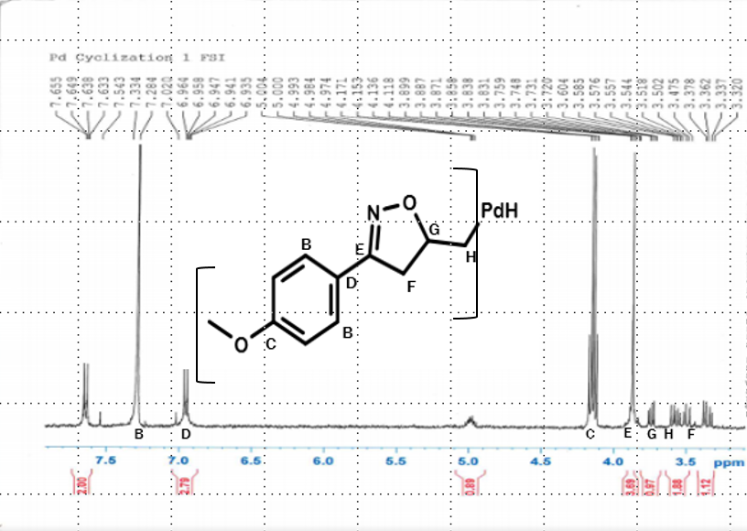
Proton NMR of palladium-catalyzed 3,5-Disubstituted ∆²-isoxazoline

Slide 30
Discussion
Why are the yields so low?
Number of Possibilities:
Reactants are not ideal
Derivatives are no strong enough to hold shape
Skill level of researchers
Miscalculations / human error

Slide 31
Discussion Continued
What happened with the nickel?
The proton NMR suggests that the compound was not fully made
Why?
The conditions were not ideal for the nickel
Nickel was not oxidized fully
Impurities in starting material
Miscalculations of mass

Slide 32
Discussion Continued
What happened with the palladium?
The NMR shows that the palladium was more pure than the nickel
Why did one work and not the other?
Conditions were ideal for palladium
Palladium is better than nickel at cyclizing
Palladium is strong enough to keep the isoxazole ring formed

Slide 33
Future Studies
Because there is little research on the nickel cyclization, it is likely that there will be more in the future
This research will cease if it is confirmed that the nickel does not work well
Due to the success of the palladium, scientists will continue to study why it works
This research will all be aimed towards effectively synthesizing an ideal form of isoxazoline
Hopefully it will become an effective treatment for diabetes and cancer in the near future

Slide 34
Acknowledgements
Samuel Ben Schottler (research mentor)
Matthew DeSelm (paper, poster, and presentation advisor
Dr. Michael D. Mosher (head of UNC’s chemistry department)

